Slide 1

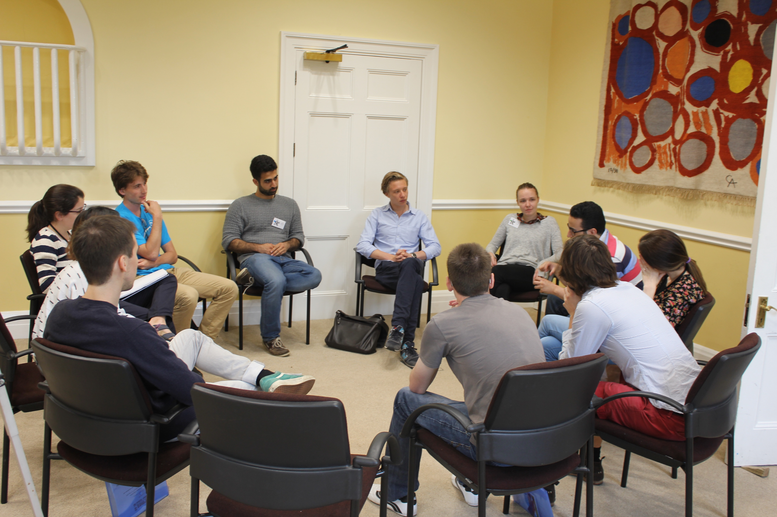
School for
early career material researchers
A student-led event, bringing together training in both materials modelling and science communication
When
19th - 23rd July 2018
Where
FEATURES
Cumberland Lodge
Materials Modelling Masterclasses
Communication Workshops
Group Projects
Poster and Networking Sessions
The Great Park, Windsor, UK SL4 2HP
Participating institutions
Imperial College London
University of Cambridge
University College London
University of York
University of Toronto
The Open University
The Thomas Young Centre
Hermessummerschool.org
@hermessummerschool
@Hermes_Comms

